Slide 1
Angular basics
Components and their interaction

Slide 2
Data binding
<li>{{user.name}}</li> – interpolation
<my-component [user]></my-component> – property binding
<li (click)=”someMethod()”></li> – event binding
<input [(ngModel)]="hero.name"> – two-way binding

Slide 3
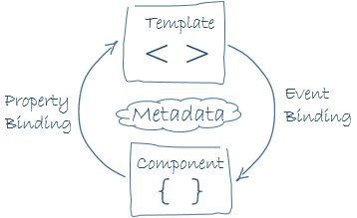
Data binding

Slide 4
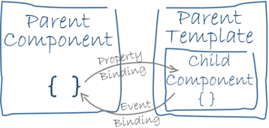
Interaction between components

Slide 5
Dependency Injection
In software engineering, dependency injection is a technique whereby one object supplies the dependencies of another object.
A dependency is an object that can be used (a service).
An injection is the passing of a dependency to a dependent object (a client) that would use it.
The service is made part of the client's state. Passing the service to the client, rather than allowing a client to build or find the service, is the fundamental requirement of the pattern.

Slide 6
Without DI
Application needs Foo (e.g. a controller), so:
Application creates Foo
Application calls Foo
  Foo needs Bar (e.g. a service), so:
  Foo creates Bar
  Foo calls Bar
    Bar needs Bim (a service, a repository, …), so:
    Bar creates Bim
    Bar does something

Slide 7
With DI
Application needs Foo, which needs Bar, which needs Bim, so:
Application creates Bim
Application creates Bar and gives it Bim
Application creates Foo and gives it Bar
Application calls Foo
  Foo calls Bar
    Bar does something

Slide 8
With DI container
Application needs Foo so:
Application gets Foo from the Container, so:
  Container creates Bim
  Container creates Bar and gives it Bim
  Container creates Foo and gives it Bar
Application calls Foo
  Foo calls Bar
    Bar does something

Slide 9
Q&A

